Slide 1
tnhealthcarecampaign.org

Slide 3
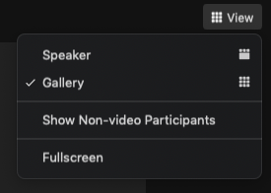
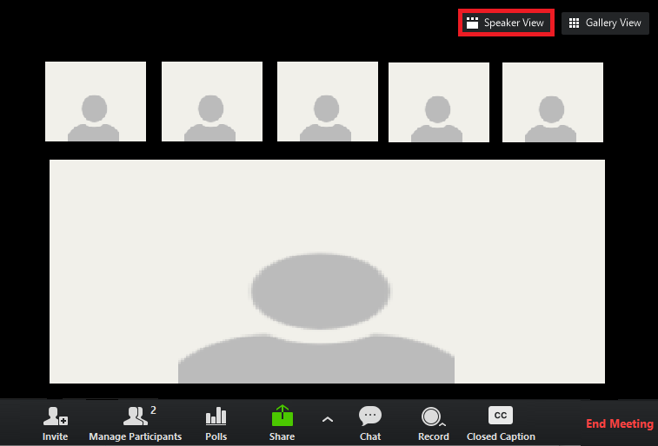
Zoom Logistics
Notes:
You can customize your view.
We recommend you use speaker view.
You can drag and drop the videos during slide share.

Slide 4
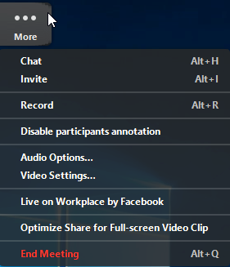
Zoom Logistics & Suggestions
This session will be recorded.
Please mute your microphone, except when engaging in discussion for Think Tank Breakout Discussion.
Use the chat box for questions for our speakers or Zoom questions.

Slide 5
Thank you to our Platinum sponsors!

Slide 6
Thank you to our Platinum sponsors!
Randall & Meryl Rice
Tony & Madeline Garr

Slide 7
Thank you to our Gold sponsors!
Clare Sullivan & Mark Brooks

Slide 8
Thank you to our Silver sponsors!
Knoxville Local Organizing Group, THCC
Barbara Reynolds
Peacemaking Committee of the Presbytery of East Tennessee

Slide 9
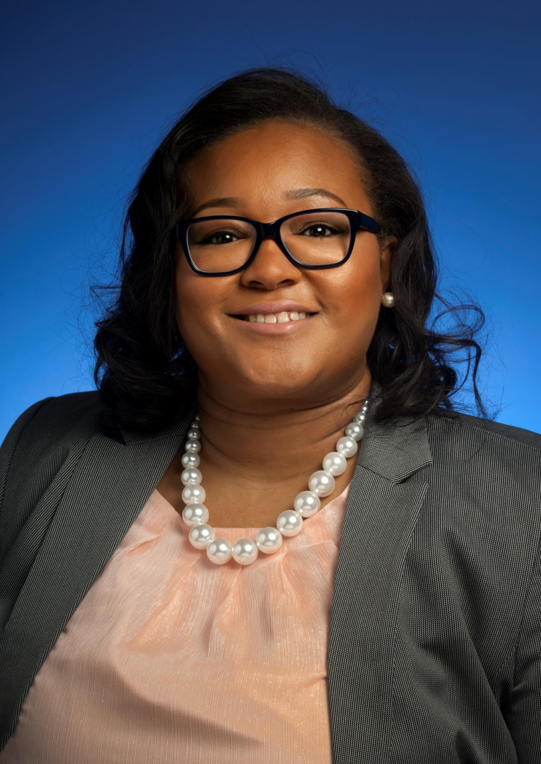
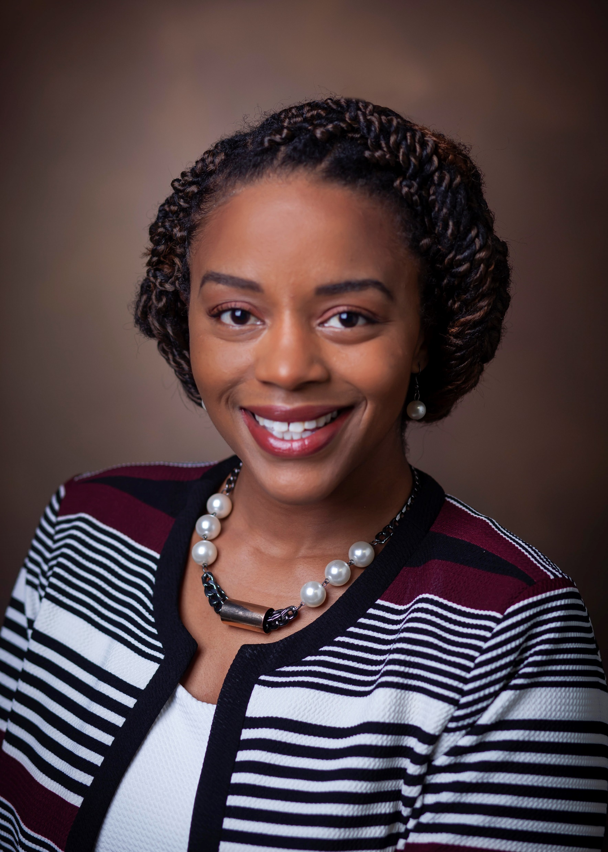
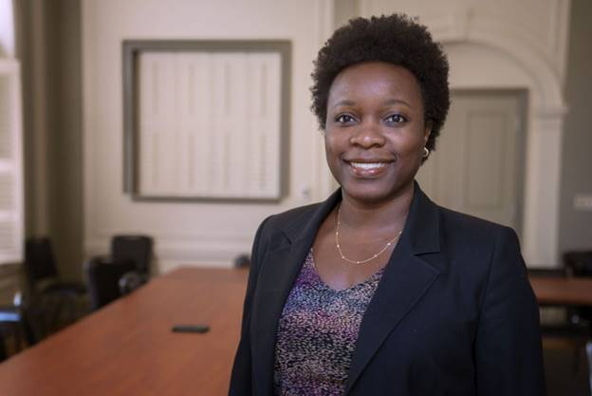
Tennessee Health Care Campaign Virtual Conference Series
Monique Anthony, MPH, CHES
Tennessee Health Department
Jacquelyn S. Favours, MPH
Health Leads
Kinika Young, JD
Tennessee Justice Center
October 17, 2020, 10 AM CST
Session 1 | Understanding Health Equity, Racial Justice & Access

Slide 10
Achieving Health Equity in an Era of Change
WELCOME!
Tennessee Health Care Campaign 4-Pt. Virtual Conference Series

Slide 11
Thank you to our Bronze sponsors!
Communications Resources
Interfaith Worker Justice of East Tennessee
Mental Health America of the MidSouth
NAMI: National Alliance on Mental Illness of Tennessee
PFLAG Nashville
SOCM: Statewide Organizing for Community eMpowerment

Slide 12
Thank you to our Bronze sponsors!
Tennessee Alliance for Progress
Tennessee Nurses Association
Tennessee Voices for Children
The Arc of Tennessee
Donna DeStefano

Slide 15
Zoom Logistics
Notes:
You can customize your view.
We recommend you use speaker view.
You can drag and drop the videos during slide share.

Slide 16
Zoom Logistics & Suggestions
This session will be recorded.
Please mute your microphone, except when engaging in discussion for Think Tank Breakout Discussion.
Use the chat box for questions for our speakers or Zoom questions.

Slide 17
Thank you to our Platinum sponsors!

Slide 18
Thank you to our Platinum sponsors!
Randall & Meryl Rice
Tony & Madeline Garr

Slide 19
Thank you to our Gold sponsors!
Clare Sullivan & Mark Brooks

Slide 20
Thank you to our Silver sponsors!
Knoxville Local Organizing Group, THCC
Barbara Reynolds
Peacemaking Committee of the Presbytery of East Tennessee

Slide 21
Tennessee Health Care Campaign Virtual Conference Series
Monique Anthony, MPH, CHES
Tennessee Health Department
Jacquelyn S. Favours, MPH
Health Leads
Kinika Young, JD
Tennessee Justice Center
October 17, 2020, 10 AM CST
Session 1 | Understanding Health Equity, Racial Justice & Access

Slide 22
Achieving Health Equity in an Era of Change
WELCOME!
Tennessee Health Care Campaign 4-Pt. Virtual Conference Series

Slide 23
Thank you to our Bronze sponsors!
Communications Resources
Interfaith Worker Justice of East Tennessee
Mental Health America of the MidSouth
NAMI: National Alliance on Mental Illness of Tennessee
PFLAG Nashville
SOCM: Statewide Organizing for Community eMpowerment

Slide 24
Thank you to our Bronze sponsors!
Tennessee Alliance for Progress
Tennessee Nurses Association
Tennessee Voices for Children
The Arc of Tennessee
Donna DeStefano

Slide 26
Annual Conference for Advocates…
Notes:
We’ve been doing an annual conference for many years, but this year we will be doing it a bit differently…

Slide 27
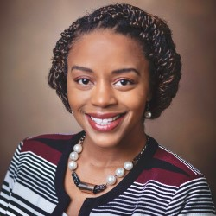
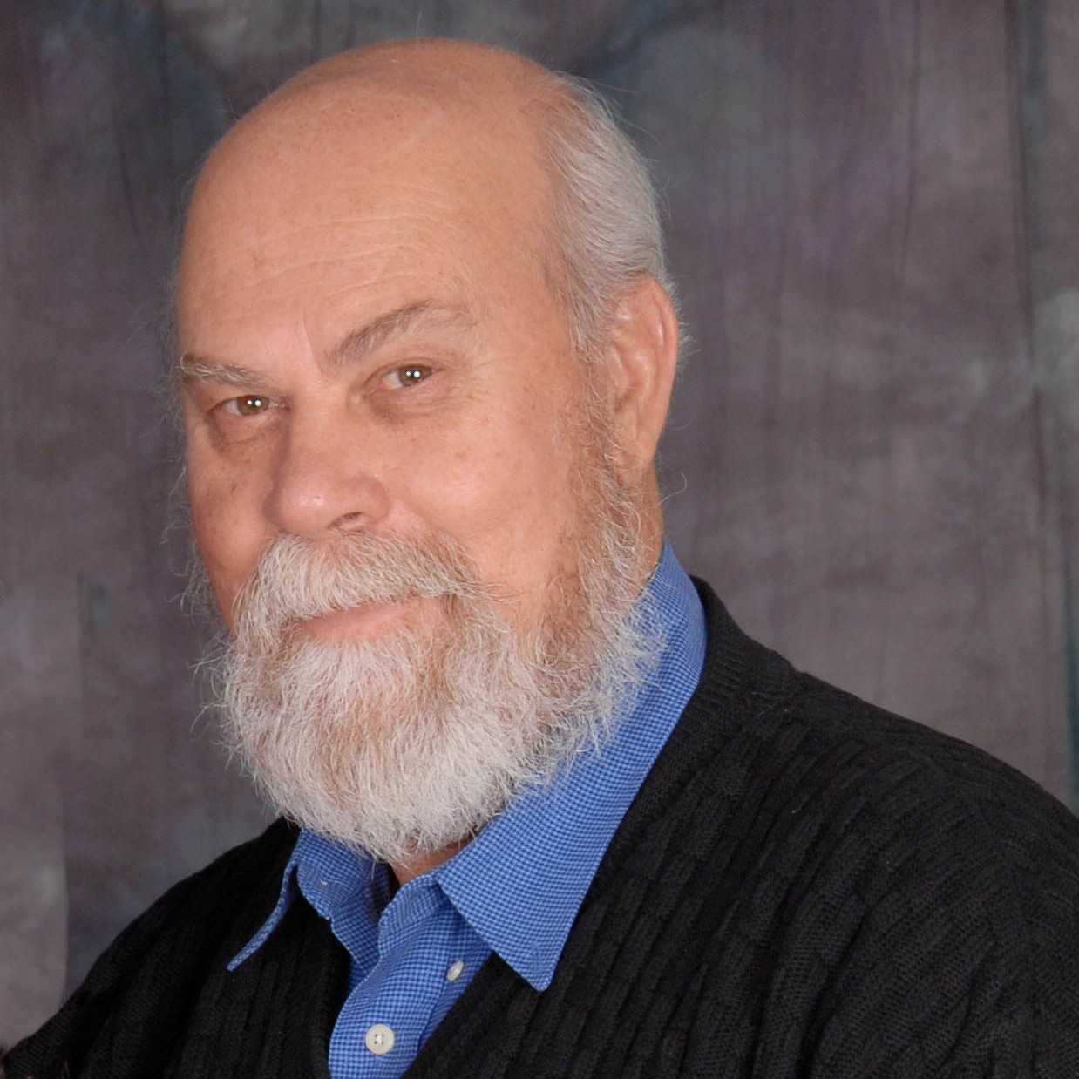
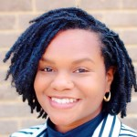
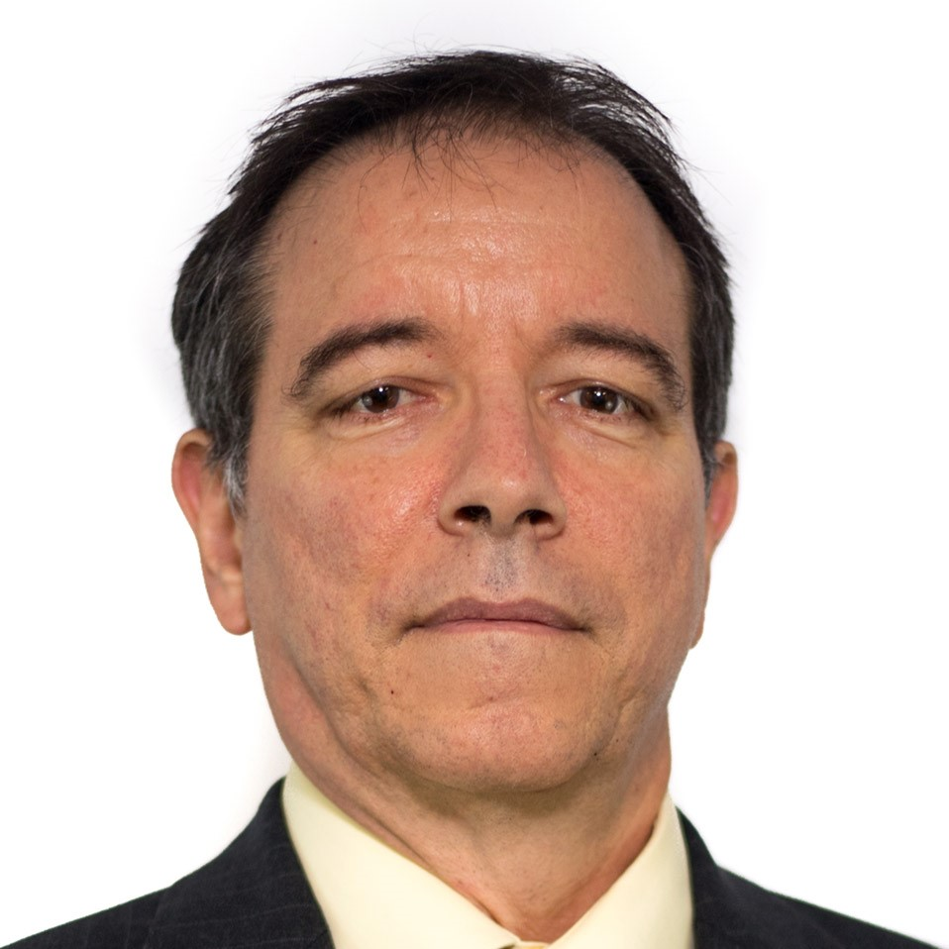
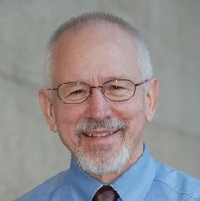
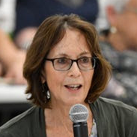
THCC Conference Committee
Ali Hulten-Stoop
Jacquelyn Favours
Margaret Axelrod
Randall Rice
Michael Heinrich
Chanda Dunn
Jose Davila
Tony Garr
Clare Sullivan

Slide 29
Logistics & Zoom Suggestions
Notes:
You can customize your view.
We recommend you use speaker view.
You can drag and drop the videos during slide share.

Slide 30
Logistics & Zoom Suggestions
This session will be recorded.
Please mute your microphone, except when engaging in discussion for Think Tank Breakout Discussion.
Use the chat box for questions for our speakers or Zoom questions.

Slide 31
Understanding Health Equity
Jacquelyn Favours, MPH
Health Leads, Director of Community Engagement

Slide 32
Understanding Health Equity
Jacquelyn S. Favours, MPH

Slide 33
A little girl with dreams of equality.
American ideals of justice, liberty and equality for all.
Leader of the free world.
The high school ‘Math’ assignment that prepared me for life.
A realization of inequality.
A college student with no health insurance.

Slide 34
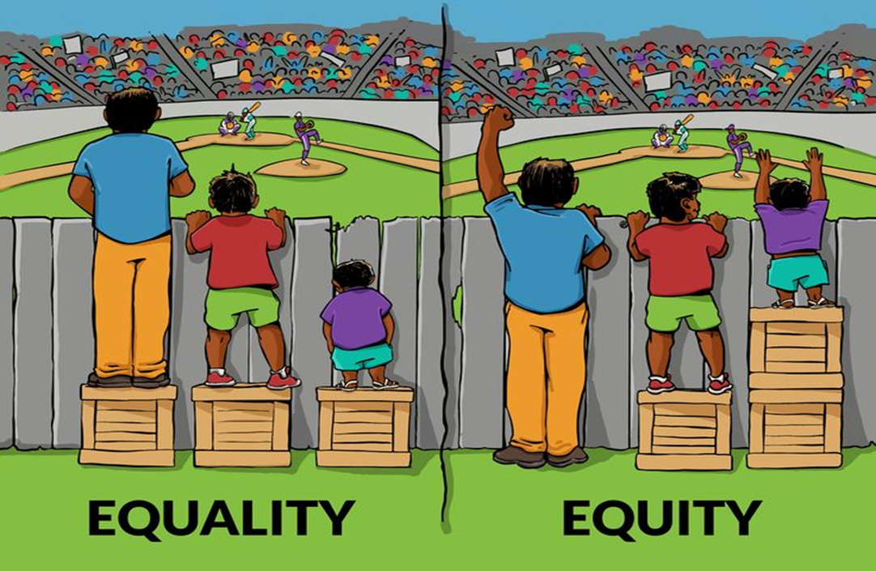
Equality vs. Equity
EQUALITY
The same thing
Works when everyone starts in the same.
EQUITY
Everyone gets what they need; fairness.
Source: Story Based Strategy (2019)

Slide 35
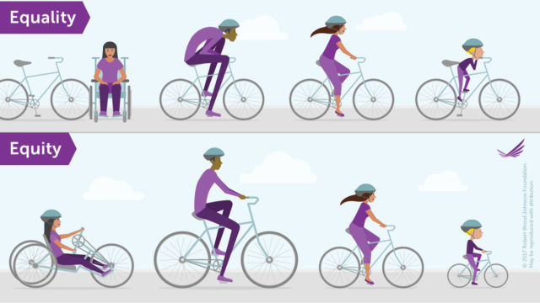
Health Equity
Health equity represents the goal or vision for public health!
Aims for equal opportunity.
Achieved when every person has equal access to health.
Achieved when social and environmental factors (income, neighborhood, education level, etc.) no longer predict a person or community’s health outcomes.

Slide 36
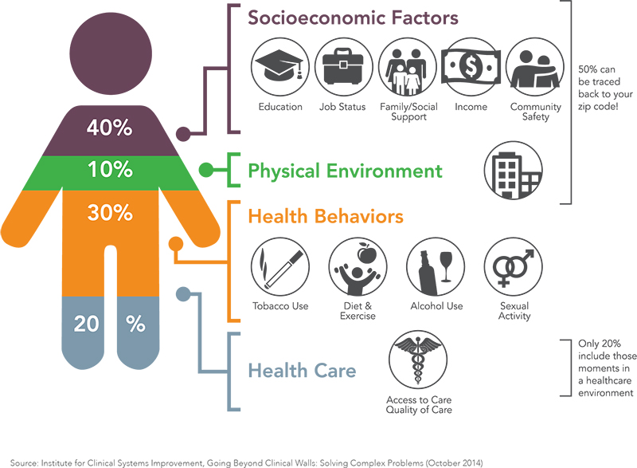
Social and Environmental factors determine 50% of an individual’s health status.

Slide 37
What are the Social and Environmental factors that determine health?
Source: Blue Cross Blue Shield (2019)

Slide 38
Health Inequities
Differences in health status between more and less socially and economically advantaged groups, caused by systematic differences in social conditions and processes that effectively determine health. Health inequities are avoidable, unjust, and therefore actionable.
Unequal distribution of resources
Definition source: Minnesota State Health Department, 2019

Slide 39
Systemic inequities keep us from having a healthier community.
A system designed to advantage or disadvantage another population, group or community.
Typically based on culture, identity, race or other social difference.
Housing, Education, Transportation and other systems structured to benefit specific groups
Functioning on a system of equality perpetuates the inequities.

Slide 40
What happens when we act on health equity?
When we work on health equity as a collective, we gain:
Bridge differences.
Healthier policies.
Healthier communities.
Less suffering from peers, family, friends and ourselves.
Create change.
Source: Institute for Healthcare Improvement

Slide 41
Thank you!
jfavours@healthleadsusa.org

Slide 42
Rooted in Racism: An Analysis of Health Disparities in Tennessee
Kinika Young, JD
Tennessee Justice Center, Senior Director of Health Policy and Advocacy

Slide 43
Rooted in Racism: An Analysis of Health Disparities in Tennessee
Kinika Young, JD
Senior Director of Health Policy and Advocacy
Tennessee Justice Center
kyoung@tnjustice.org

Slide 45
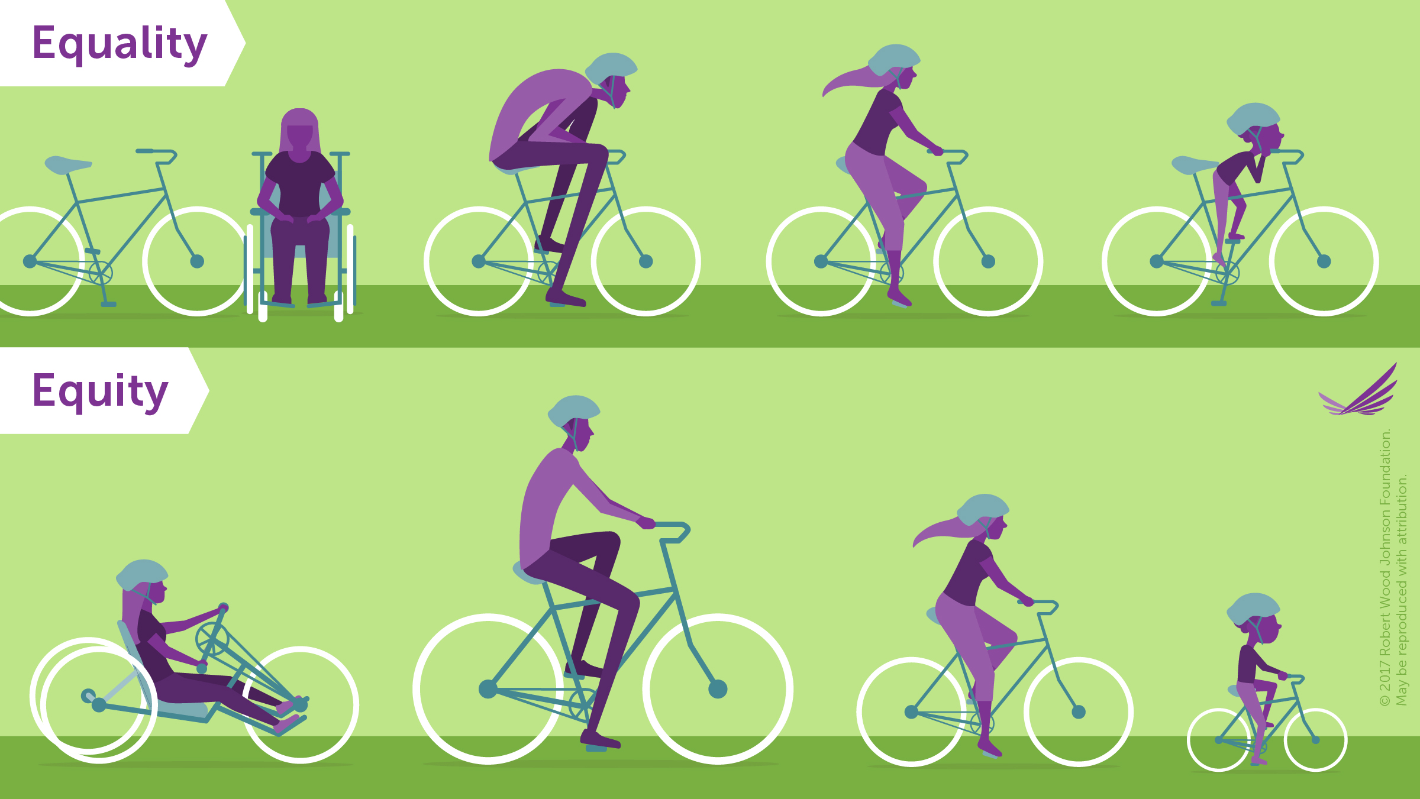
What is health equity?
Everyone has access to what they need to be as healthy as possible
Why not “equality”?

Slide 46
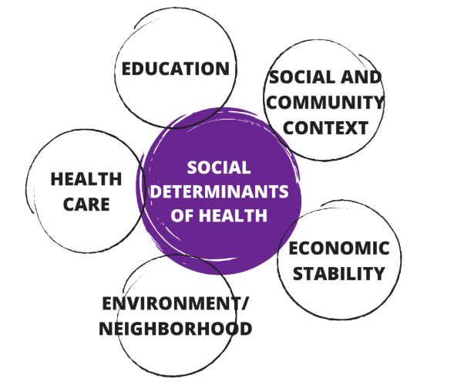
Social Determinants of Health
“…Health is much more than an interaction in a provider’s office. Health starts where people live, labor, learn, play and pray.”
- Howard K. Koh, MD, MPH, Health and Human Services Assistant Secretary for Health

Slide 47
Health Inequities by the Numbers
Costs
Health Care System Cost = $93 billion
Economic Costs = $135 billion
Demographic Trends
2012: majority of births of color
2020: majority of people 18 and under will be of color
By 2050, fixing problem will add $230 billion annually to U.S. economy
TODAY: majority of kids under age 10 of color
2045: majority of country will be of color

Slide 48
Historical Context
1860s – smallpox virus and other public health concerns led to formation of the medical division of the Freedmen’s Bureau — the nation’s first federal health care program
1945 – President Truman proposed a “universal national health insurance program”
American Medical Association opposed it
1948 – President Truman won re-election and revived call for health insurance program
AMA opposed it again with help from other national organizations
… private health insurance plans rose in popularity and labor unions collectively bargained for their members’ health benefits…
1964 – President Johnson signed the Civil Rights Act
1965 – President Johnson created Medicare and Medicaid
AMA again opposed the programs but this time the National Medical Association fought back in support
… health care costs continue to rise, experiments with HMOs and HDHPs, uninsured rates remain high…
2010 – President Obama enacted the Patient Protection and Affordable Care Act

Slide 49
Longstanding Barriers Playing Out Today
Misinformation
Health care provider bias
Impact of medical assaults (e.g. Tuskegee syphilis research study) on Black Americans’ mistrust of healthcare system
Inadequate access to resources to meet basic needs
Overrepresentation in “essential” workforce
Unemployment

Slide 50
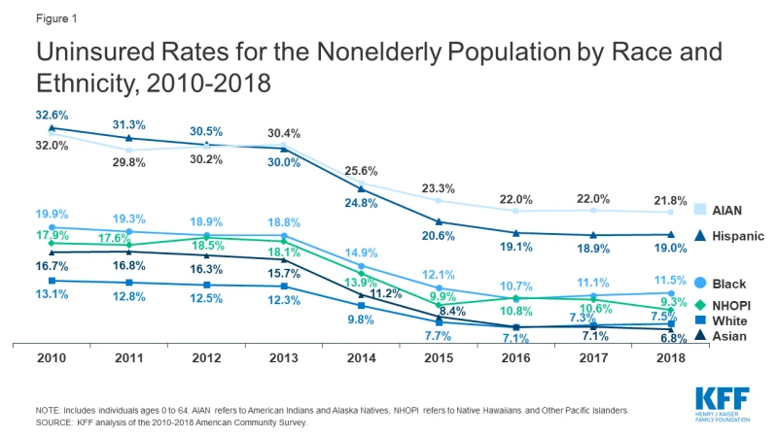
Access to Health Care
Black Americans are 1.5 times more likely to be uninsured than White Americans
Less than half of private sector employers offer health insurance to employees
Health care costs are unaffordable
Health care spending as a percent of GDP is higher in the U.S. than any other developed nation

Slide 51
The Affordable Care Act

Slide 53
Medicaid Expansion in TN
Bring $1.4 billion annually into the state
Help hospitals at-risk of closing
Create 15,000 health care jobs
Provide health insurance to 300,000+ Tennesseans
Improve access to care and health outcomes, particularly for people of color

Slide 54
For more information
https://www.tnjustice.org/health-equity/

Slide 55
Thank you!
“Of all the forms of inequality, injustice in health care is the most shocking and inhumane. I see no alternative to direct action and creative nonviolence to raise the conscience of the nation.”
-Martin Luther King, Jr.
www.facebook.com/tnjustice
www.twitter.com/tnjusticecenter
info@tnjustice.org

Slide 56
Health Disparities and the Impact of COVID-19
Monique Anthony, MPH, CHES
Tennessee Department of Health, Director of the Office of Minority Health & Disparities Elimination

Slide 57
Tennessee Health Care Campaign Conference Office of Minority Health & Disparities Elimination
October 17, 2020

Slide 58
Mission & Vision
Mission of OMHDE
Empower communities to support optimal health for all and eliminate disparities for racial, ethnic and under-served populations
Vision of OMHDE
To serve as a statewide leader, recognizing and addressing health disparities and health equity, through meaningful collaboration and engagement

Slide 59
COVID-19 Data Discussion
Data updated 2PM daily website (www.tn.gov/health), social media
Source: https://www.tn.gov/health/cedep/ncov.html

Slide 60
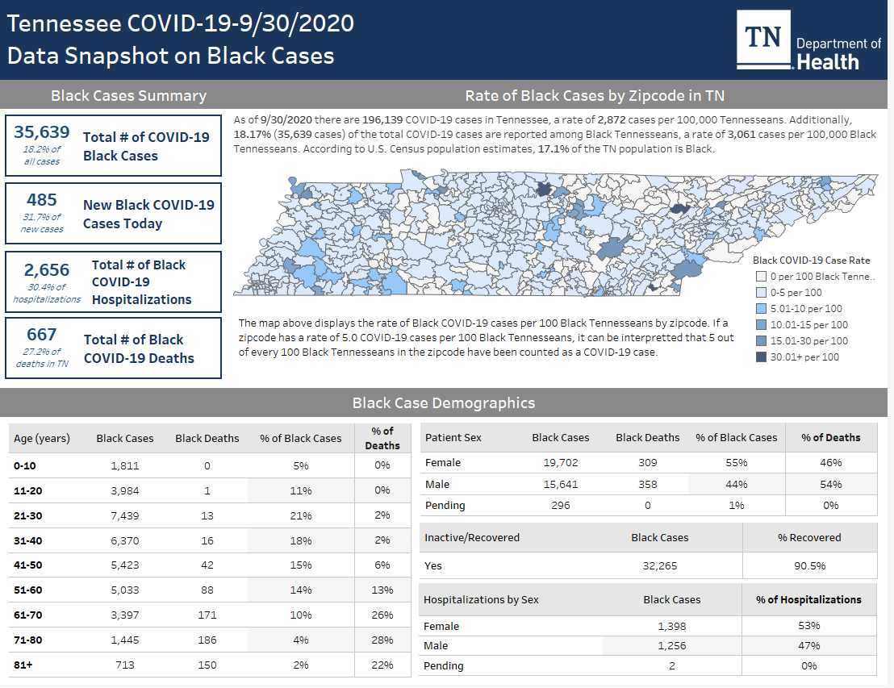

Slide 61
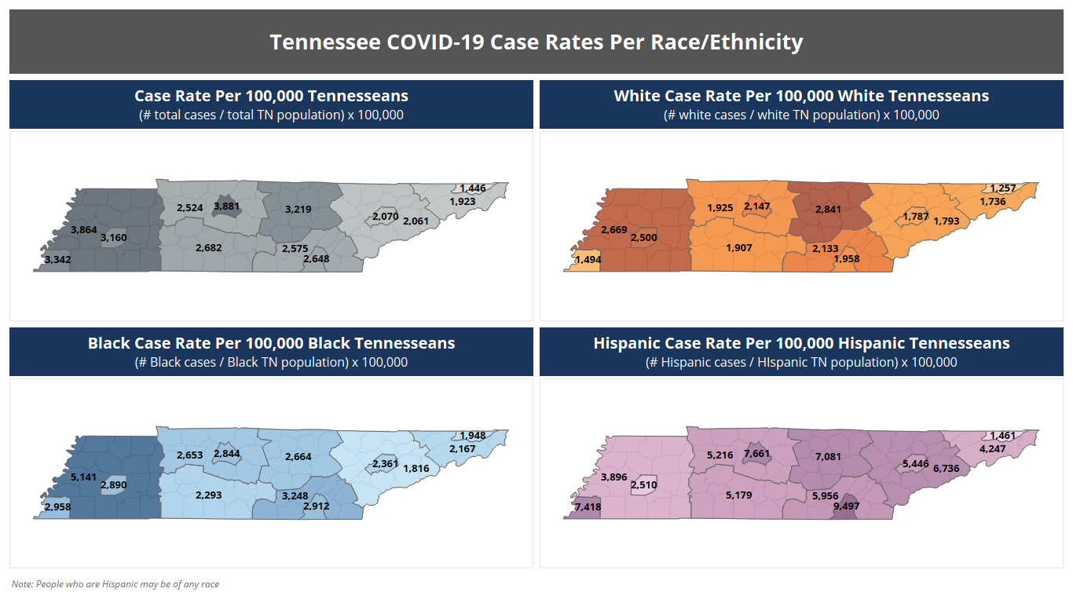

Slide 62
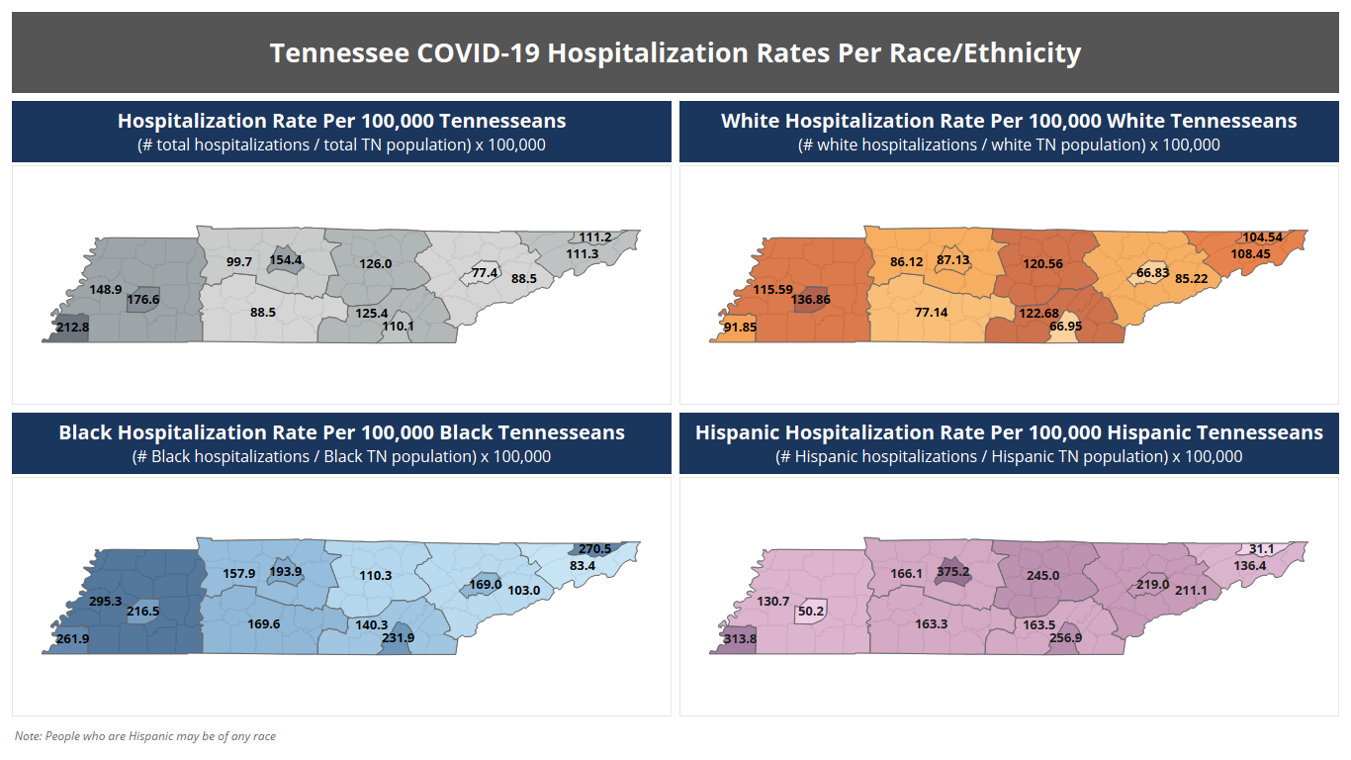

Slide 63
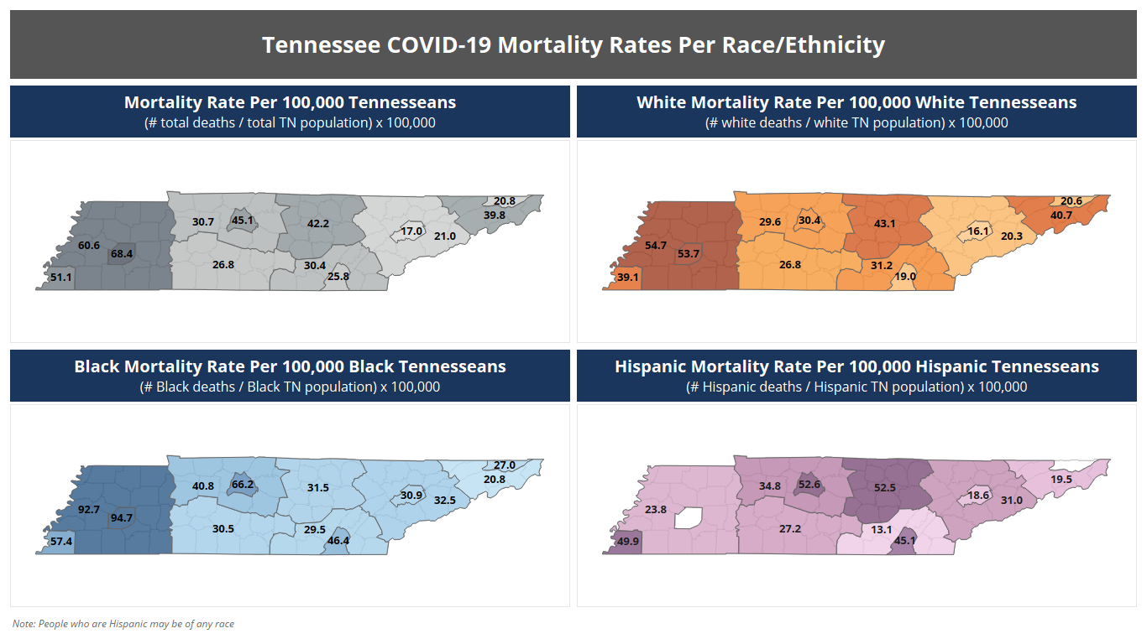

Slide 64
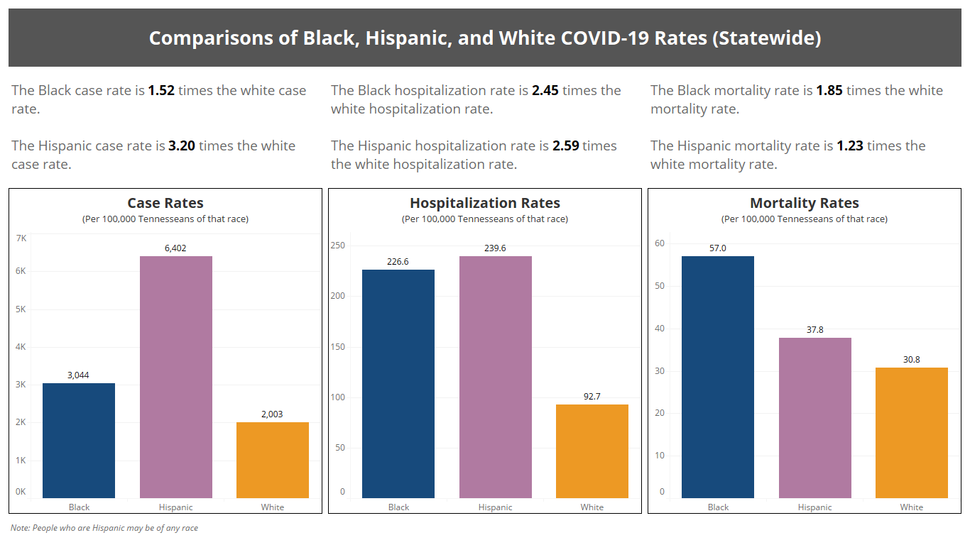

Slide 65
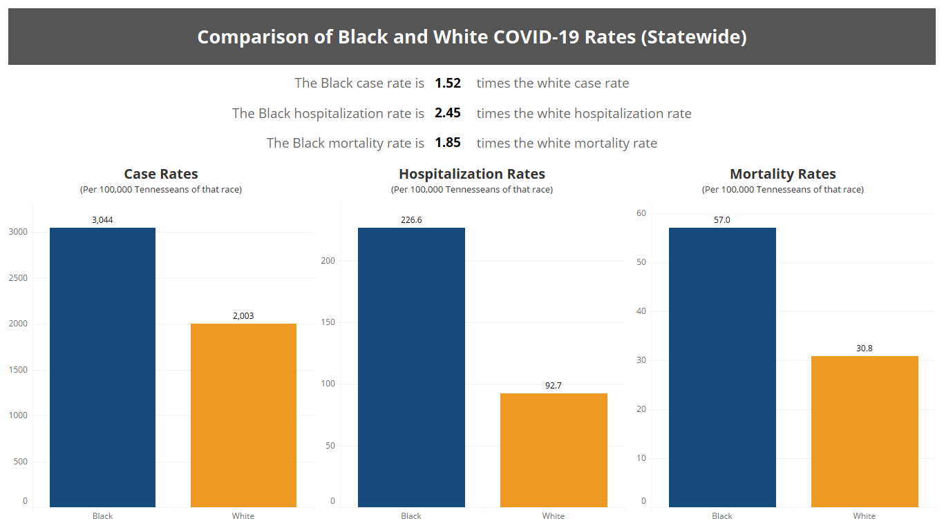

Slide 66
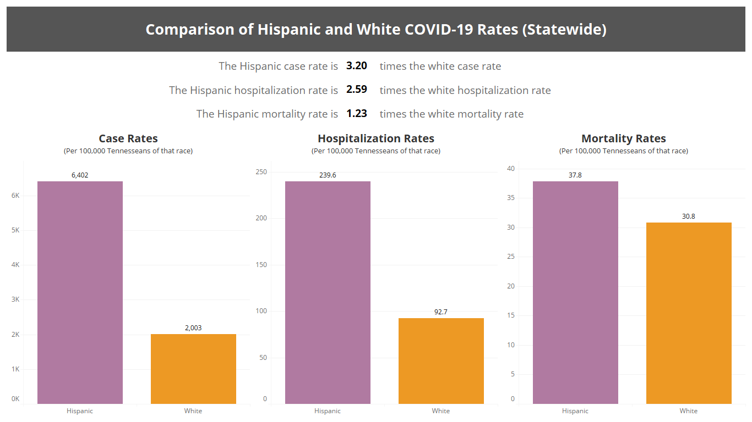

Slide 67
Community Engagement & Outreach

Slide 68
Communications & Marketing
5 Commercials that ran across all major networks in TN
Data led to recreating pregnancy PSA in Spanish featuring a Hispanic woman
Task Force that Meets Weekly

Slide 69
Community Concerns
Communities are not connecting with the severity of COVID-19
Essential workers and cannot afford to stay at home
Misinformation and conspiracy theories in our community.
Debunking testing myths
Fear of Deportation
Mistrust of government

Slide 70
FAITH AND COMMUNITY-BASED COVID-19 TESTING ACTIVITY REPORT
Coordinated Events
Completed Events
Individuals Tested
109
90
14,819
+4 events since last week
7 scheduled/upcoming events
5 events pending date, location, testing staff
+4 events since last week
+185 tested since last week
22% positive - Morristown, TN (Hamblen)

Slide 71
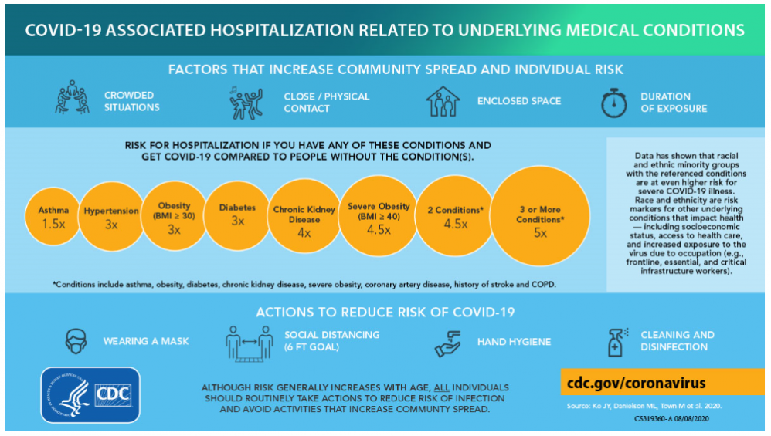
COVID-19 Risk of Hospitalization If You Have These Health Conditions

Slide 72
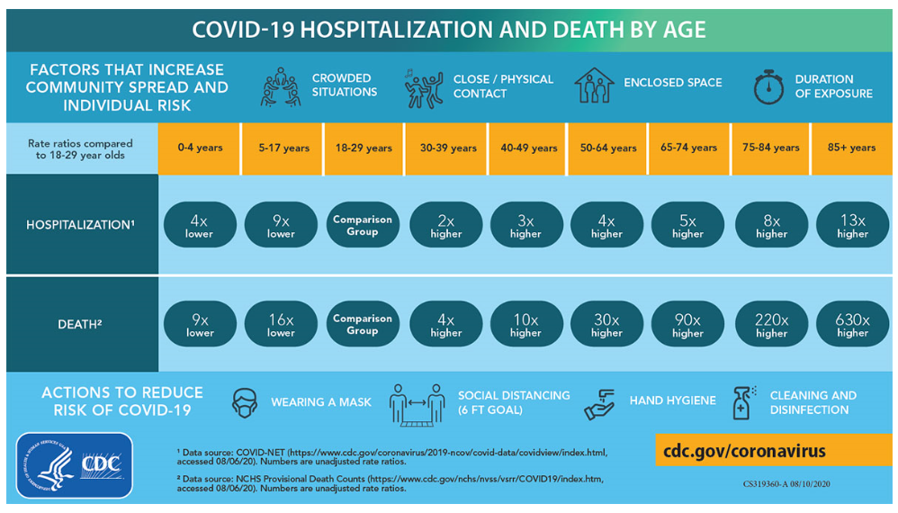
COVID-19 Hospitalization and Death by Age

Slide 73
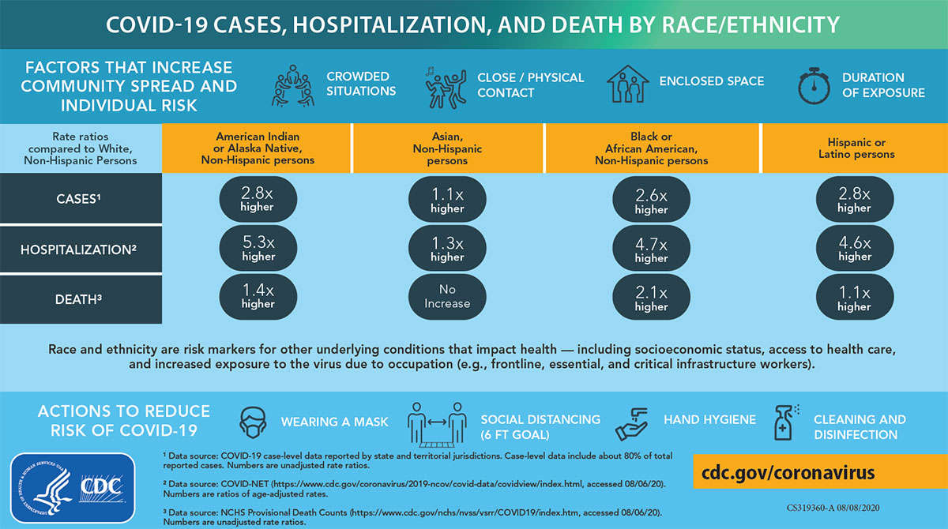
COVID-19 Hospitalization and Death by Race/Ethnicity

Slide 74
Next Steps

Slide 75
Health Equity
WHAT IS RACISM?
"Racism is a system of structuring opportunity and assigning value based on the social interpretation of how one looks (which is what we call "race"), that unfairly disadvantages some individuals and communities, unfairly advantages other individuals and communities, and saps the strength of the whole society through the waste of human resources.“
-- APHA Past-President Camara Phyllis Jones, MD, MPH, PhD

Slide 76
Next Steps
Weekly Task Force briefings (1 hour) – Thursdays 1:00 -2:00 pm throughout pandemic
Targeted communication via website, social media, local outlets
Questions and comment form on website
Health Equity Trainings
Focus Groups
Health Equity Advisory Committee

Slide 77
Questions?? Monique Anthony Director, Office of Minority Health & Disparities Elimination 629-215-0642 or Monique.Anthony@tn.gov

Slide 79
Think Tank Discussion Topics
DISCUSSION SHARING AGREEMENTS
ALLYSHIP
With Margaret Axelrod
ANTIRACISM / UNDOING RACISM
With Chanda Dunn
HEALTH EQUITY IN PRACTICE
With Jose Davila
PARTNERING FOR HEALTH EQUITY
With Jacquelyn Favours
PRESUME WELCOME, FEEL WELCOME.
Voices, thoughts, ideas and experiences are welcome.
COME TO THE CONVERSATION WITH SELF.
Use mostly “I” statements.
GENUINE FREEDOM IN SHARING.
It’s okay to respectfully disagree.
MAKE SPACE, TAKE SPACE.
Allow space for others to engage, but also try not to just witness the conversation, engage!
TURN TO WONDER.
If things get difficult, turn to wonder – listen & learn.
Notes:
To remind all of us in the room of how we want to participate, including the facilitators.
Allyship – Discuss how are persons of privilege being supportive of vulnerable individuals and communities. (Facilitator: Margaret Axelrod)
Antiracism / Undoing racism - Explore what racism means to others and practices that can be used to begin reversing the effects of racism. (Facilitator: Chanda Dunn)
Health Equity in Practice - Discuss how providers and/or their organizations are working to make sure equitable services are being provided. (Facilitator: Jose Davila)
Partnering for Health Equity - Engaging partners, from elected officials to community members in equity work makes a large impact. Discuss the power of having community partners in equity work. (Facilitator: Jacquelyn Favours)

Slide 80
State & Federal General Election Day is November 3rd!
EARLY VOTING
Early Voting | Wednesday, October 14 – Thursday, October 29, 2020
Absentee (Mail-In) Ballot Request Deadline Tuesday, October 27, 2020
Election Day – November 3rd

Slide 82
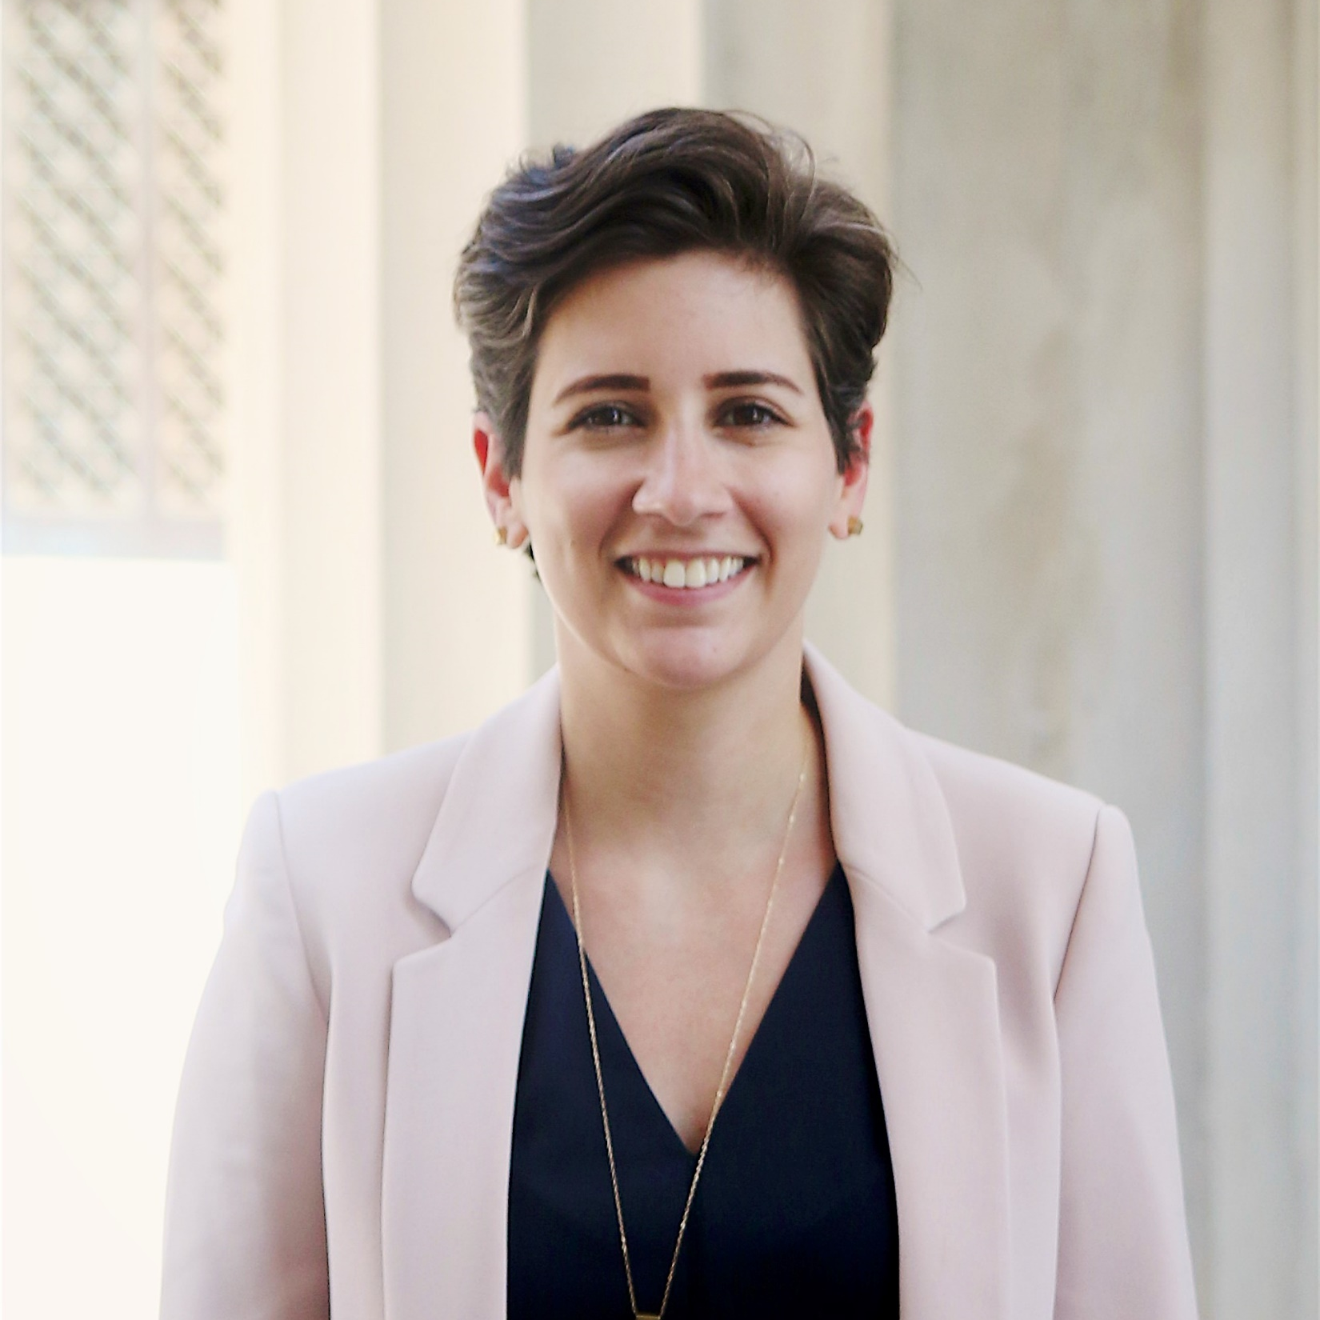
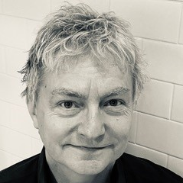
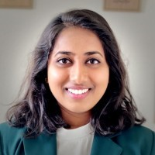
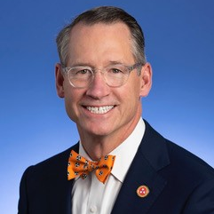
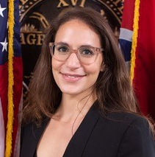
October 24th No More Surprise Medical Bills! A campaign to end this practice
Mandy Pellegrin Policy Director at the Sycamore Institute
Steve Ebe Musician, impacted by a surprise medical bill
Natasha Kumar, MPH Health Policy Analyst at Families USA
Rachel Jrade-Rice, JD Assistant Commissioner, Tennessee Department of Commerce and Insurance
Senator Bo Watson R-Hixson

Slide 83
Need Health Insurance? Open Enrollment starts Nov. 1st!
Nov. 1st - Dec. 15, free health insurance application assistance.
Call 844-644-5443.
Visit www.insurealltn.com for more details.

Slide 84
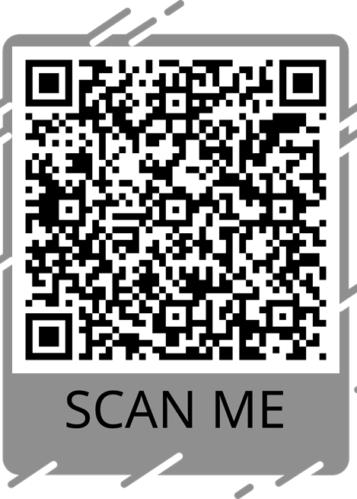
Thank you for joining us! Please take a moment to complete our brief event evaluation.
Option 1 | Click the Evaluation link in the Chat Box.
Option 2| Scan the QR code using your iPhone camera app or QR Reader app on your smart phone. open the Click the link it appears to access the survey.
Notes:
https://forms.gle/UNUqoX9KAcMjQ3TM9

Slide 85
Visit the new THCC website at https://tnhealthcarecampaign.org/

Slide 86
Achieving Health Equity for All Tennesseans
in an Era of Change
All sessions will be held from 10 am – 12 pm Central and recorded
Session 1 - October 17th
Understanding Health Equity, Racial Injustice and Access
Session 2 - October 24th
No more surprise medical bills! A campaign to end this practice
Session 3 - October 31st
Addressing Rural Health Disparities in Tennessee
Session 4 - November 14th
Closing the Coverage Gap in Tennessee
Notes:
We have a pdf we will send after this meeting to every one with these dates and topics and registration links—also on our website but these reflect the focus of our Advocacy Committee and Rural Health Team. We’ve saved the discussion of Closing the Coverage Gap til after the election…because this election as you know has the potential to change the landscape of health care for decades to come.

Slide 88
tnhealthcarecampaign.org

