Slide 1
Closing the Coverage Gap:
What to Expect from the Biden Administration

Slide 2
Non-ACA strategies: Increase Access
Make long-term care more affordable
Lower Medicare eligibility to 60
Increase funding for mental health and rural health care services

Slide 3
Expand ACA access: Increase Access
Eliminate income limits for premium subsidies
Limit percentage of income people pay for health care coverage
Add public option plan

Slide 4
Reduce costs
Address prescription drug costs
End surprise medical billing

Slide 5
Restore rights
Free access to preventive care
Health care protections all people

Slide 6
Circumstances dictate priorities and successes
Registered nurse Michelle Goldson works with a COVID-19 patient in the ICU at Martin Luther King Jr. Community Hospital on Thursday.
(Francine Orr / Los Angeles Times)

Slide 7
Health care reform priorities
ACA stabilization
Health equity
Decreasing age for Medicare eligibility
Drug pricing
Surprise medical bills

Slide 8
Reform: Executive Branch
DHHS can roll-back Trump de-regulations
Use section 1332 waivers to support state public option plans
Use Executive Orders to effect health care reform

Slide 9
Reform: Supreme Court
Uphold ACA
Overturn key provisions
Overturn entire ACA

Slide 10
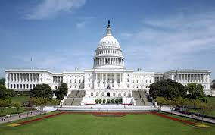
Reform: Congress
Lower Medicare eligibility age
Public option
Remove 400% FPL limit for ACA subsidies
Mitigation effects SCOTUS ACA ruling

Slide 11
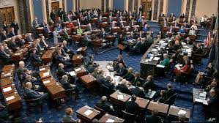
Legislative considerations
Filibuster
Reconciliation
Bipartisan support for key issues
Prescription drug pricing
Pricing transparency
Telehealth
Mental and behavioral health

Slide 12
TennCare III

Slide 13
TennCare III: Key provisions
TN may receive more federal dollars without required state match
Permitted to limit coverage of some prescription drug costs
Can make eligibility & benefits changes without further federal approval as long as maintain or improve end-of-2020 levels
Source: Sycamore Institute

Slide 14
TennCare III: Key provisions
New funding cap may be less risky than current program
Includes shared savings provision
Roll-back of waiver could take longer than prior waivers.
Source: Sycamore Institute

Slide 15
Aggregate funding cap
Enrollee-specific per capita cost:
Base: Actual TN 2019 per capita costs in 5 categories plus national rate of growth to establish a 2021 cap
Annual: National rate of growth & enrollment (+/- 1%)
No exclusions-Cap applies to all costs covered by the waiver.
Source: Sycamore Institute

Slide 16
Limit coverage of prescription drugs
TennCare can choose not to cover some prescription medications
Exemptions are also carved out for drugs to treat HIV/AIDS and opioid use disorder
State must allow exceptions when a non-covered drug is deemed medically necessary
Source: Sycamore Institute

Slide 17
Shared savings
If TennCare spending reduced by $3
 | Dollars ($) lost by state |  | Dollars ($) retained by state
TennCare II | Fed | $$ | Feds
 | State |  | State | $
TennCare III | Fed | $ | Fed | $
 | State |  | State | $
Source: Sycamore Institute

