Slide 2
Tennessee Federally Qualified Health Centers
*211 sites

Slide 3
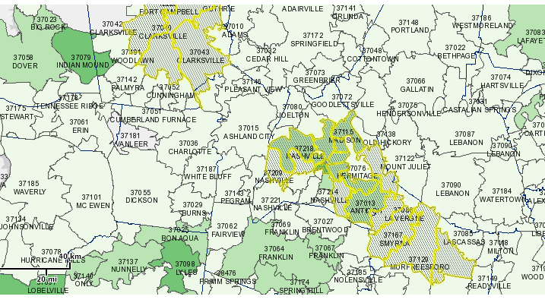
MWCHC Locations – Nashville, Clarksville and Smyrna

Slide 5
Until the Gap Closes
Safety Net Consortium of Middle Tennessee
Comprised of hospitals, academic institutions, charitable care, faith-based and federally funded organizations focused on providing care regardless of income.
My Healthcare Home
A website devoted to finding the best fit in the Safety Net
Project Access Nashville
Includes disease management, access to pharmacy services and dental
Smile On 60+
Preventive and restorative oral health services for individuals 60 years old and older

